Slide 1
Model Uncertainty using Monte Carlo Dropout
Noah Hirst-Ashuach

Slide 2
Monte Carlo Dropout
You can model the uncertainty in a NN by adding dropout during testing so that the model output is stochastic and then generating lots of predictions for the same data point.
These predictions are then interpreted as samples from a distribution of model parameters.
The model prediction is then the average of these outputs and the uncertainty is the standard deviation of the distribution

Slide 3
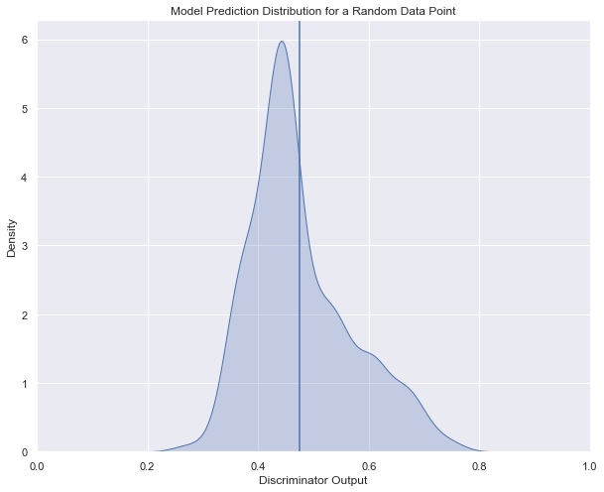
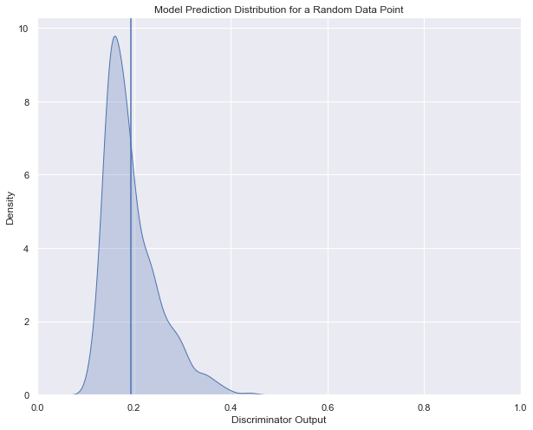
Prediction Distributions for random events

Slide 4
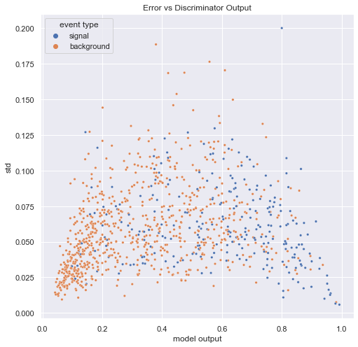
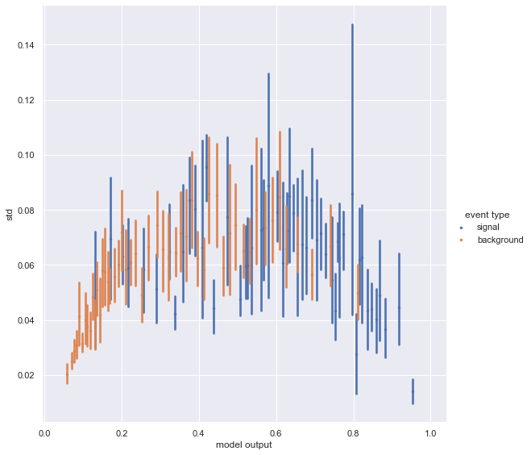
Error vs Model Output

Slide 5
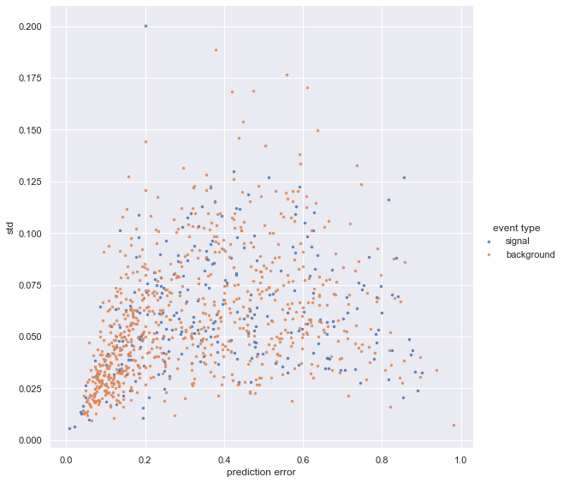
Error vs Prediction Error (y_true – y_pred)

